Slide 1
Lecture 14 – Market Basket Analysis and the Apriori Algorithm
8/20/18

Slide 2
Market Basket Analysis
Identifies items that go together or attributes that have associations
Also known as affinity analysis
Most widely known examples are retail, because of Amazon
Also used for other things like which transactions suggest a stolen credit card
Predicting degradation of a telecommunications network
Determining the proportion of cases in which a new drug will exhibit dangerous side effects

Slide 3
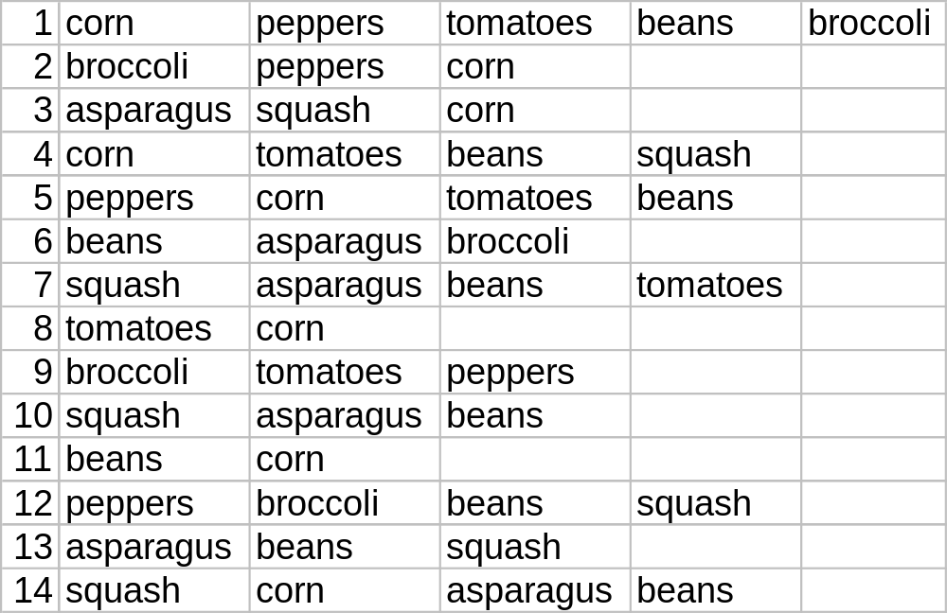
A List of Transactions from a Farm Market

Slide 4
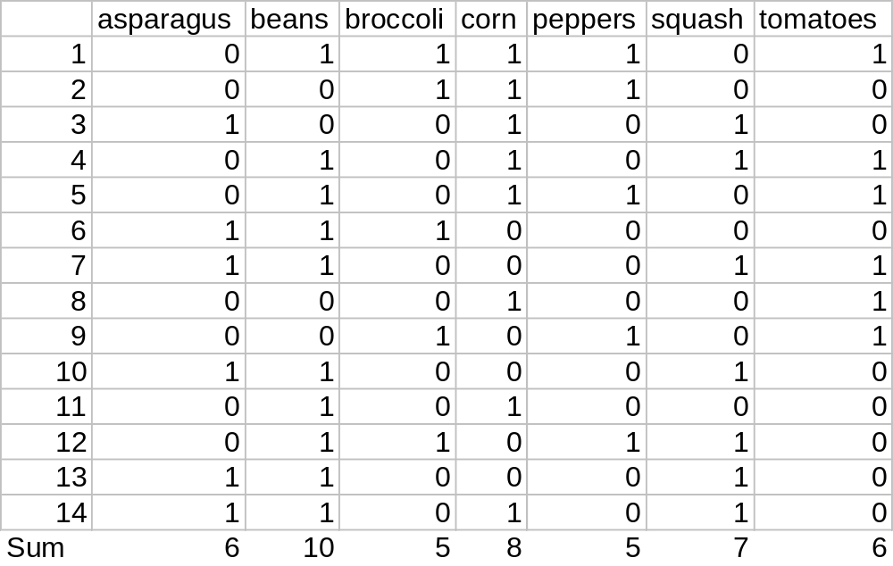
Tabular Version of Transaction Data

Slide 5
Computing Associations
We use 2 measures to identify rules for A ⇒ B
Support = (transactions containing both A and B)/(total transactions)
Confidence = (transactions containing both A and B)/(transactions containing A)
Buy Asparagus then Buy Beans
  Support = 5/14
  Confidence = 5/6
Note Buy Beans then Buy Asparagus has same support but only ½ confidence

Slide 6
Dimension is the enemy!
There can be higher dimension associations as well.
In addition to A⇒B, we can have A,B ⇒ C,
A,B,C ⇒ D etc.
Note even in this small example there are 7*6 cases for A ⇒ B, 7*6*5 cases for
A,B ⇒ C etc.
But it’s actually even more, because for binary cases we may want to predict whether A ⇒ not B etc
So if we have n items we have more than n! associations to check

Slide 7
The Apriori Algorithms Limits Dimension
The Apriori Property states that if |A|=k then
|A ⇒ B| ≤ k
In other words since Broccoli appears only 5 times, Buy Broccoli implies Buy Corn can not possibly appear more than 5 times
In the Apriori Algorithm we limit dimension by choosing a k level

Slide 8
All Possible Combinations with k≥4
{asparagus,beans}→5, {asparagus,squash}→5, {beans,corn}→5, {beans,squash}→6, {beans,tomatoes}→4, {broccoli,peppers}→4, {corn,tomatoes}→4
{asparagus,beans,squash}→4,
{beans,corn,tomatoes}→4
No combinations with 4 vegetables or more
Now compute confidence and support for each possibility above

Slide 9
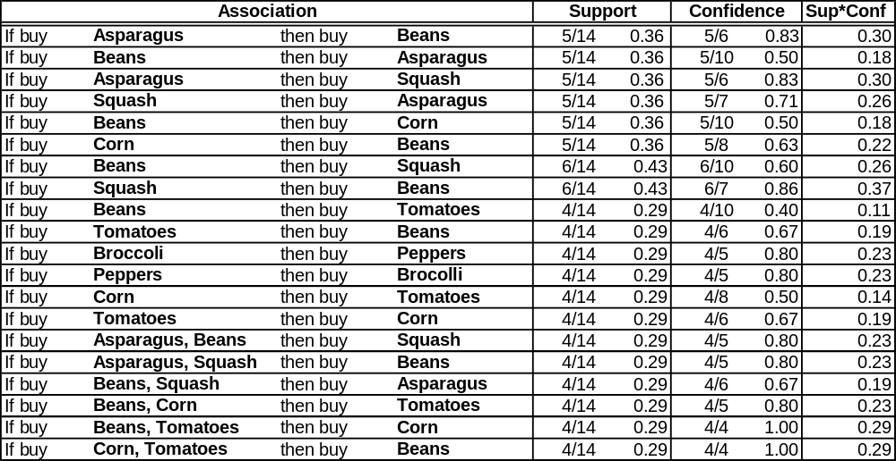
Associations

Slide 10
R Implementation
In R the function for doing Market Basket Analysis is called Apriori and it takes a set of transactions, a target support, and a target confidence threshold.
It returns association rules, confidence, support, and also lift which is Support(A,B)/(Support(A)*Support(B))
I find Confidence*Support to be more useful than lift, but unfortunately that is not computed
Go To R

Slide 11
Movies and Groceries
Convert Movies8.csv to Movies10.csv in Excel
Go to R
Groceries.csv from https://github.com/stedy/Machine-Learning-with-R-datasets
Do Groceries Example in R

